Slide 1
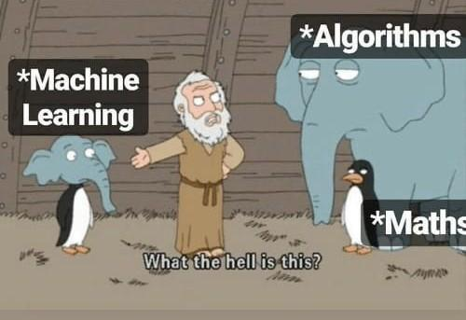
Introduction to Machine Learning
Speaker Meet Bhanushali

Slide 2
What is Machine Learning
Machine learning is an application of artificial intelligence that involves algorithms and data that automatically analyse and make decision by itself without human intervention.
It describes how computer perform tasks on their own by previous experiences.
Therefore we can say in machine language artificial intelligence is generated on the basis of experience.

Slide 3
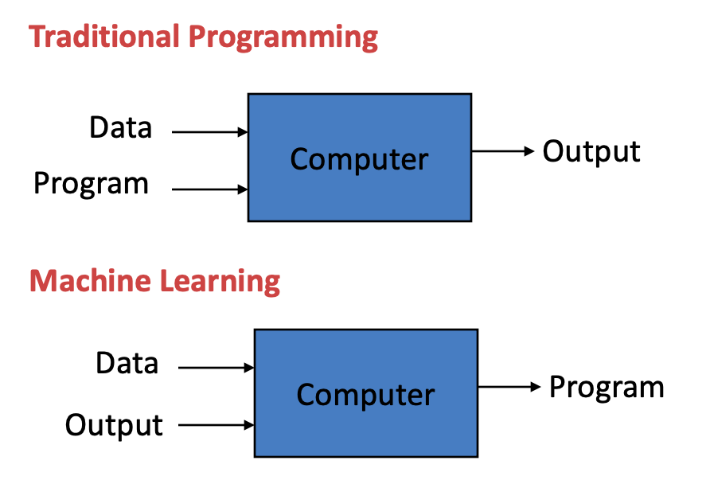

Slide 4
Types of Machine Learning
There are three types of machine learning
Supervised learning
Unsupervised learning
Reinforcement learning

Slide 5
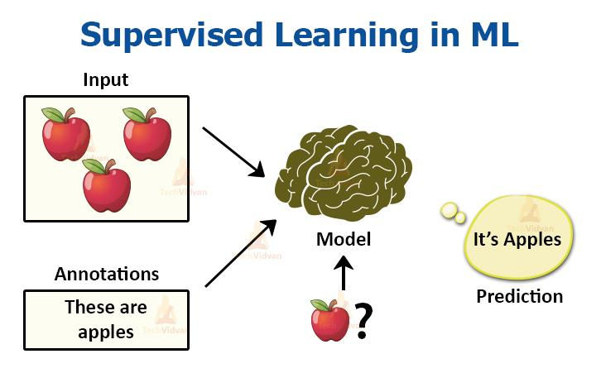
Supervised Learning
Supervised learning is the types of machine learning in which machines are trained using well "labelled" training data, and on basis of that data, machines predict the output. The labelled data means some input data is already tagged with the correct output.
In the real-world, supervised learning can be used for Risk Assessment, Image classification, Fraud Detection, spam filtering, etc.

Slide 6
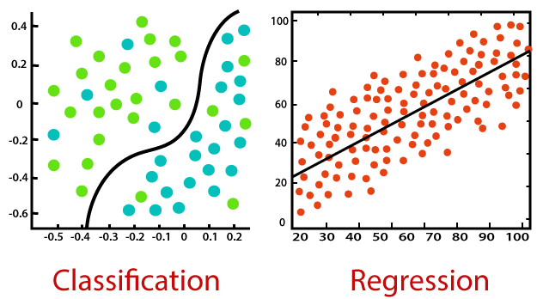
Supervised Learning
Supervised Learning is further divided into 2 types of problems

Slide 7
Supervised Learning
Regression
Regression algorithms are used if there is a relationship between the input variable and the output variable.
For example, Regression algorithms are used in weather forecast, Market Trends, etc.
Below are some popular regression algorithms
Linear Regression
Regression Trees
Non-Linear Regression
Bayesian Linear Regression
Polynomial Regression

Slide 8
Supervised Learning
2. Classification
Classification algorithms are used when the output variable is categorical, which means there are two classes such as Yes-No, Male-Female, True-false, etc.
Some Classification algorithms are :-
Random Forest
Decision Trees
Logistic Regression
Support vector Machines

Slide 9
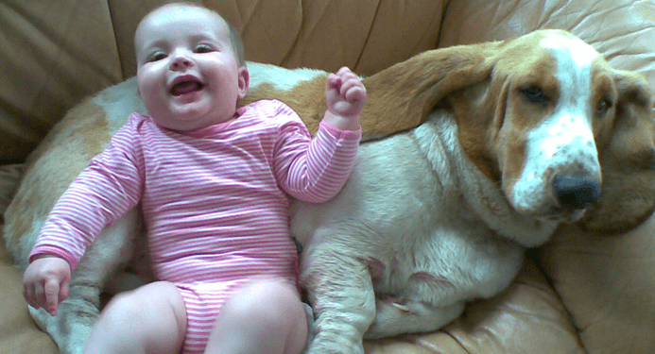
Unsupervised Learning

Slide 10
Unsupervised Learning
Unsupervised Machine Learning Algorithms are further divided into 2 problems
Clustering
Association

Slide 11
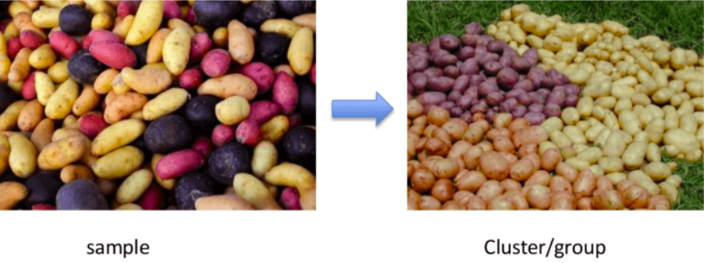
Unsupervised Learning
Clustering
Clustering mainly deals with finding a structure or pattern in a collection of uncategorized data.
Unsupervised Learning Clustering algorithms will process your data and find natural clusters(groups) if they exist in the data.

Slide 12
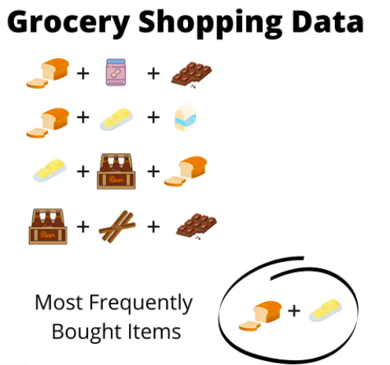
Unsupervised Learning
Association
This unsupervised technique is about discovering interesting relationships between variables in large databases

Slide 13
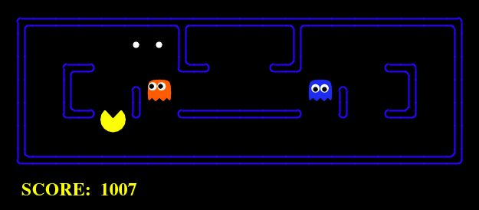
Reinforcement Learning
Reinforcement Learning(RL) is a type of machine learning technique that enables an agent to learn in an interactive environment by trial and error using feedback from its own actions and experiences.

Slide 14
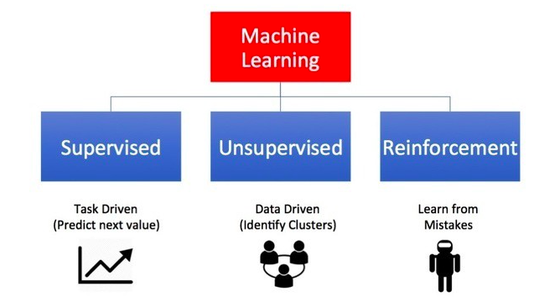

Slide 15
Machine Learning Uses:
Traffic prediction
Virtual Personal Assistant
Speech recognition
Email spam and malware filtering
Bioinformatics
Natural language processing

Slide 16
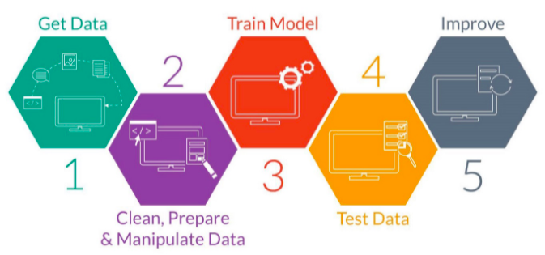
Flow to Solve any Machine Learning Problem

Slide 17
Thank you

